Slide 1
Name: Pawan yadav Class: TY Bsc IT Roll No.: 1901421 Sem.: VI Project.:Game Development (Platformer Game Development) Guide Name: Mrs. Rupali Jawale

Slide 2

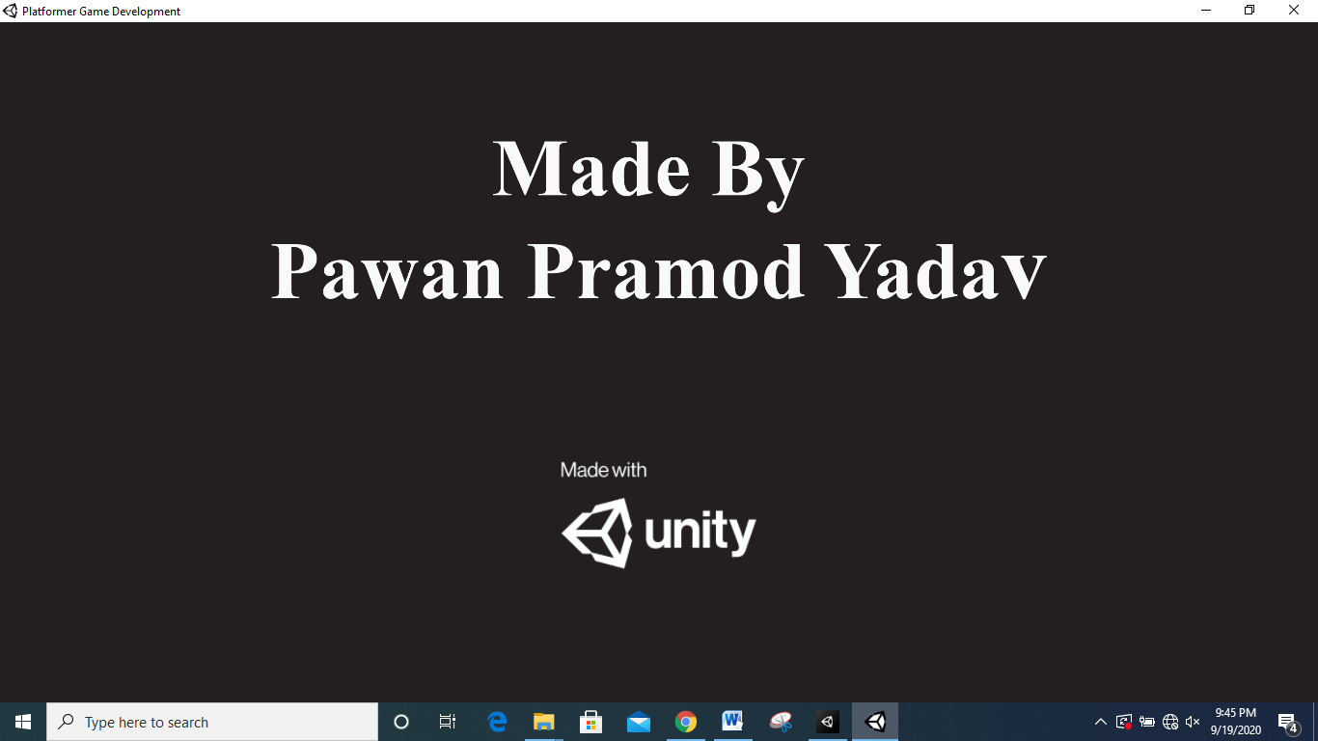

Slide 3
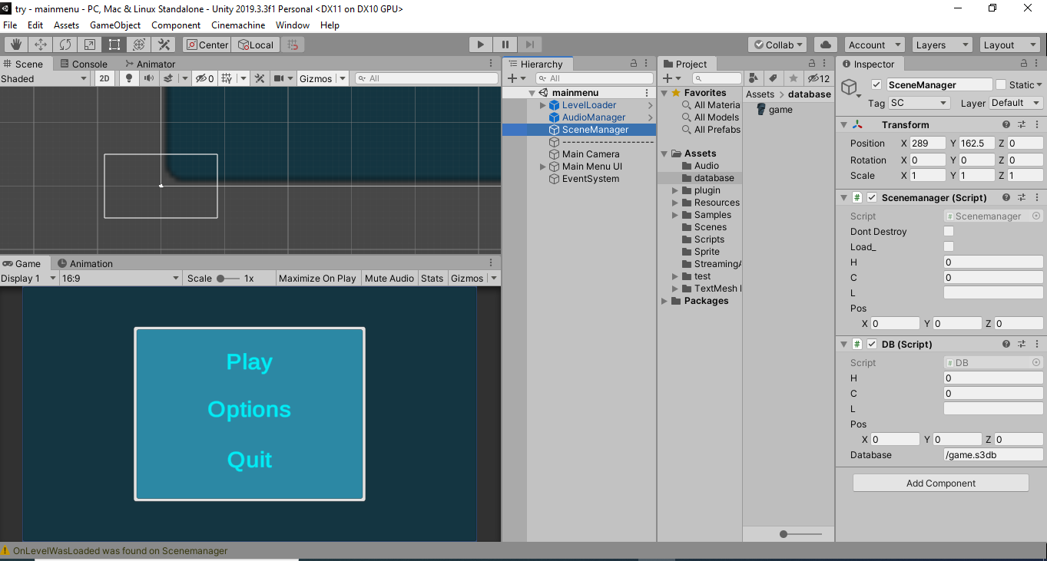
Project
Scene Window
Unity Window
Assets
Inspector
Game Window
Hierarchy

Slide 4
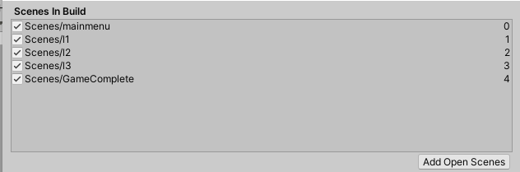
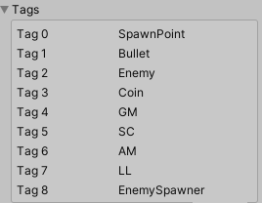

Slide 5
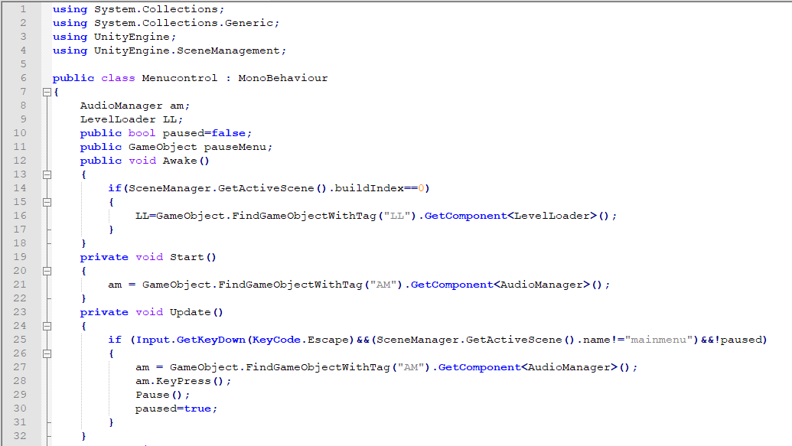
MenuControl.cs
MenuControl.cs

Slide 6
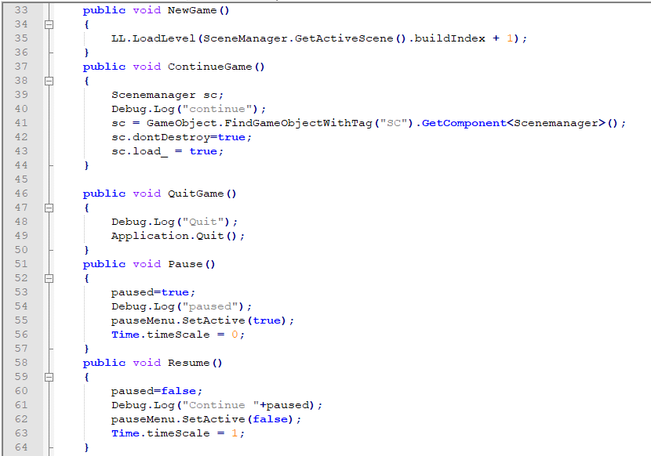
MenuControl.cs

Slide 7
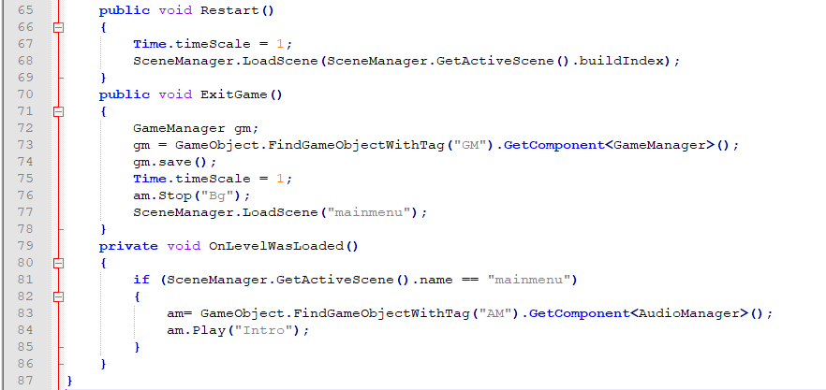
MenuControl.cs

Slide 8
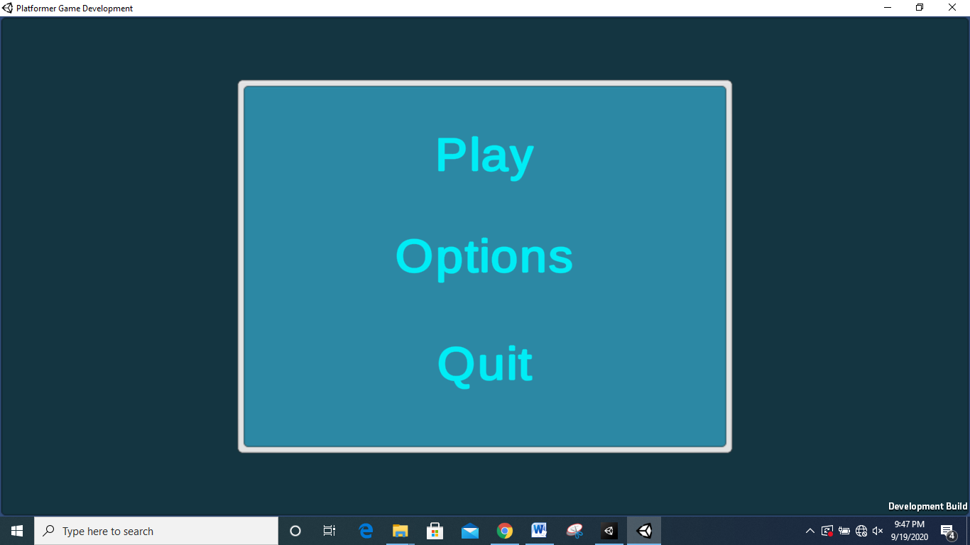
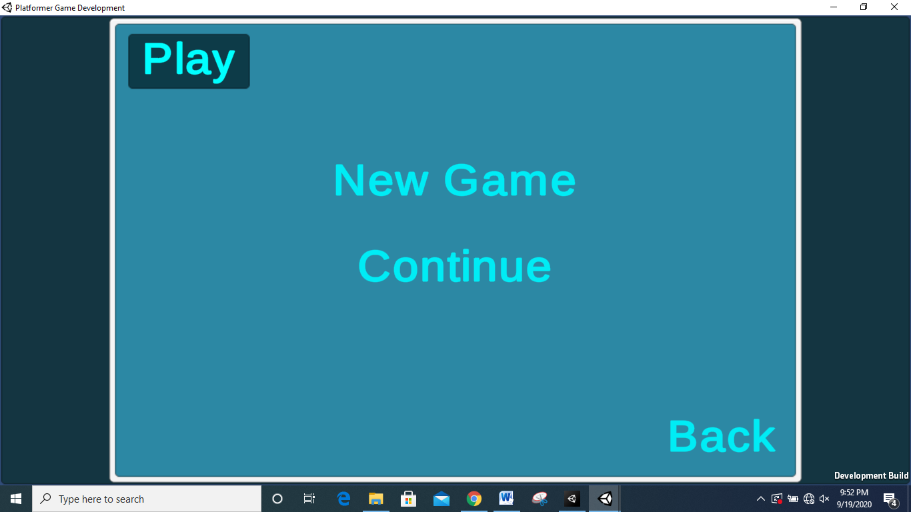
MainMenu
PlayMenu

Slide 9
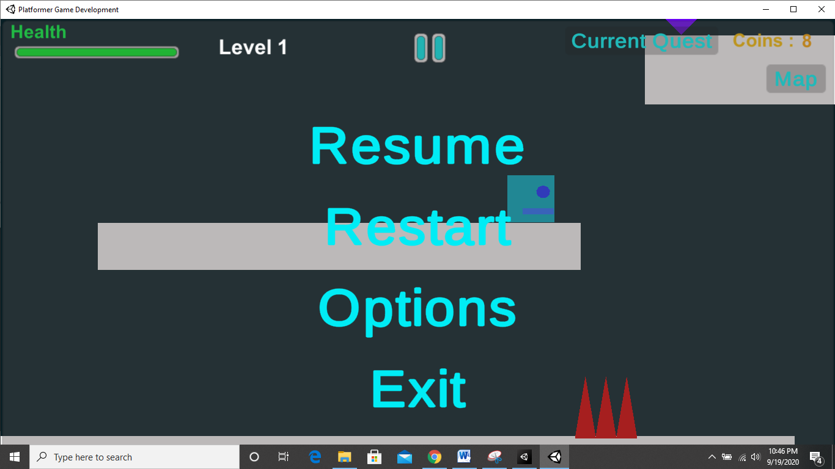
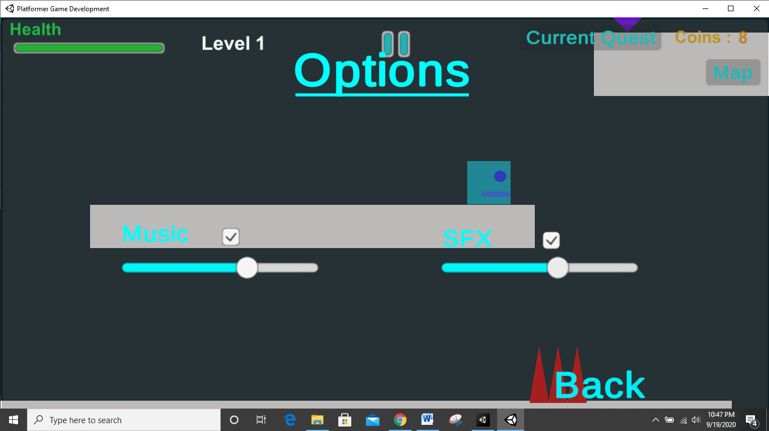
PauseMenu
Option Menu in PauseMenu

Slide 10
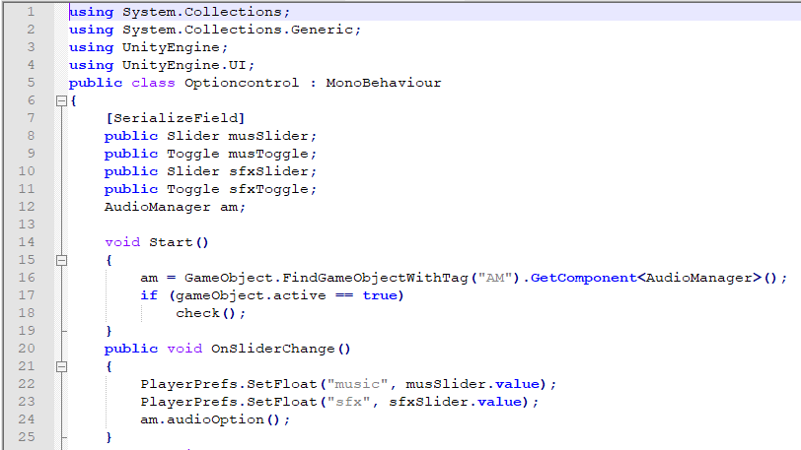
Optioncontrol.cs
Optioncontrol.cs

Slide 11
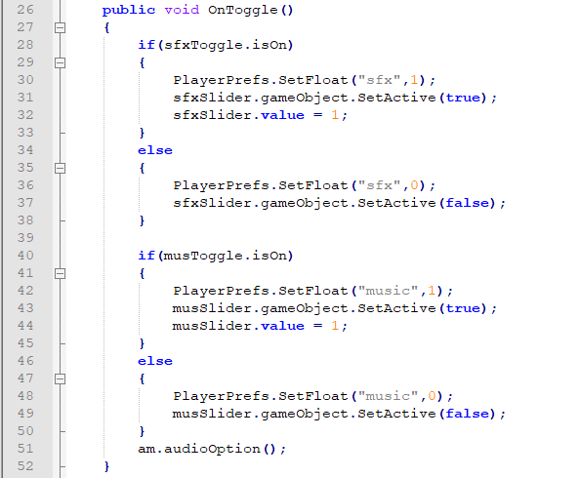
Optioncontrol.cs

Slide 12
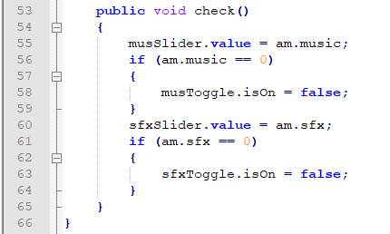
Optioncontrol.cs

Slide 13
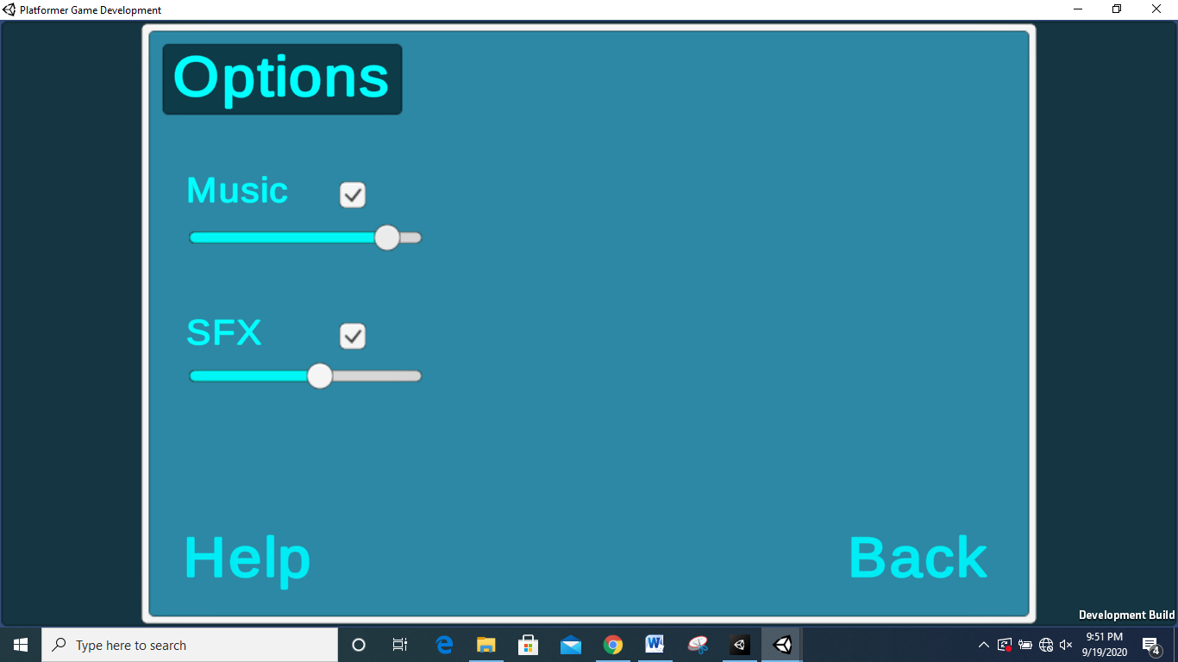
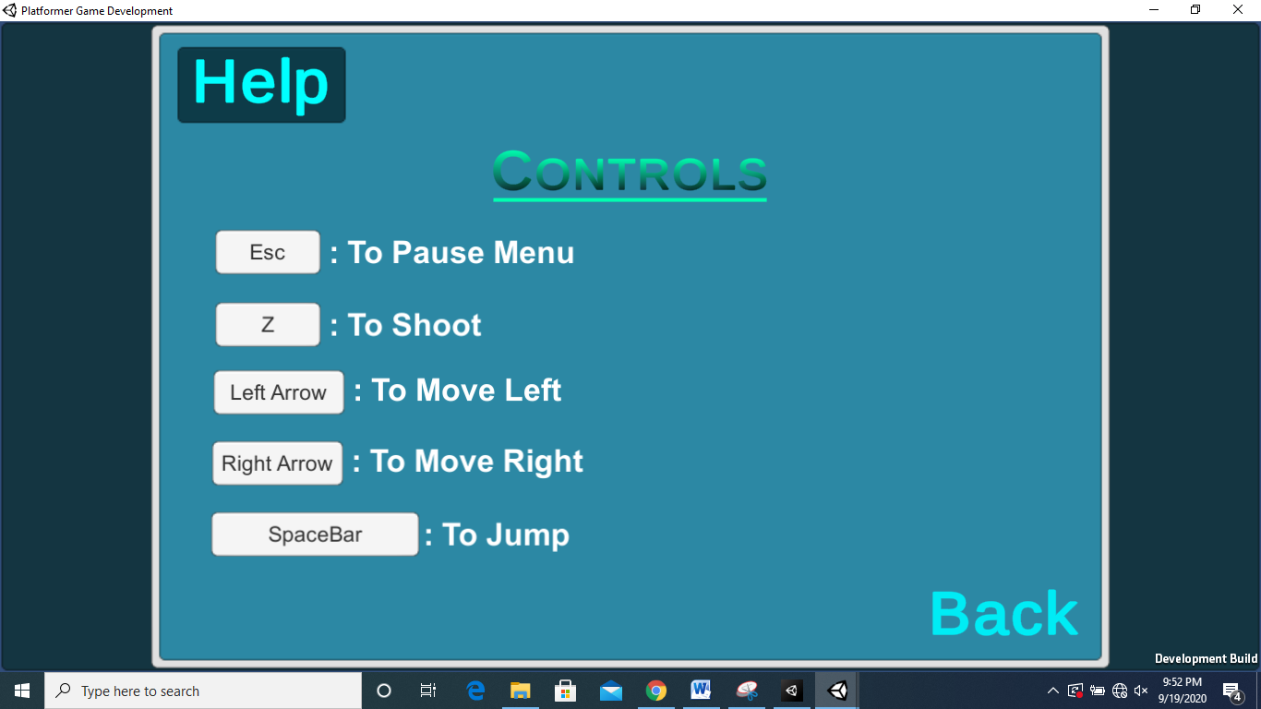
OptionMenu
HelpMenu

Slide 14
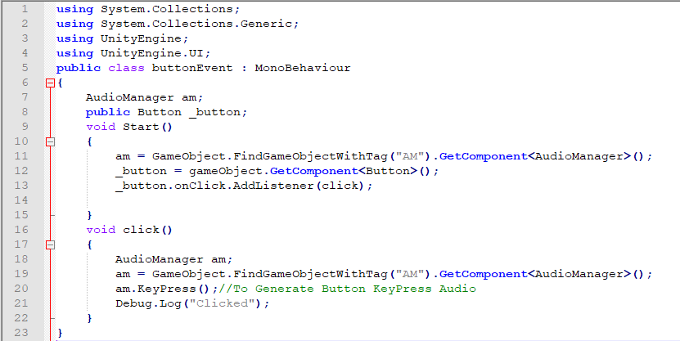
ButtonEvent.cs
ButtonEvent.cs
To Generate Button Click Sound.

Slide 15
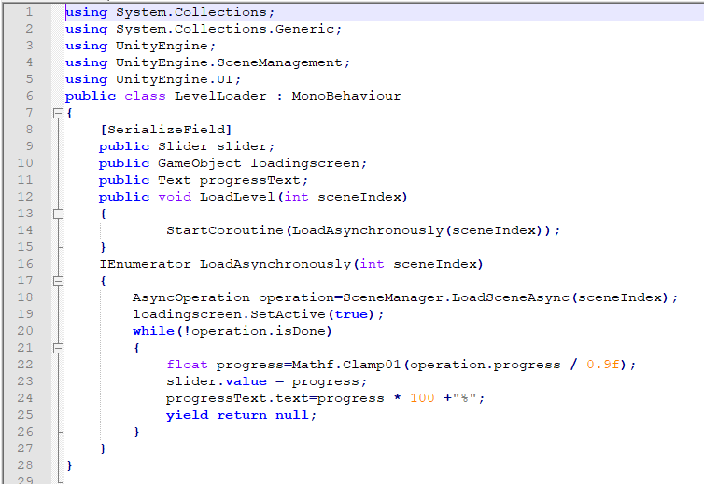

LevelLoader.cs
LevelLoader.cs

Slide 16
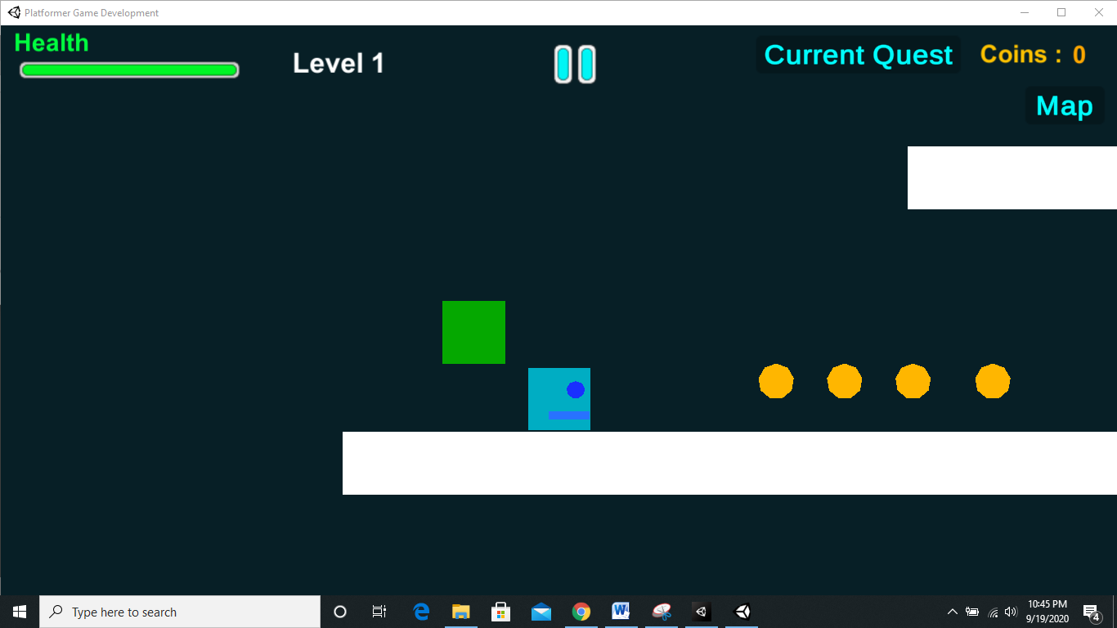
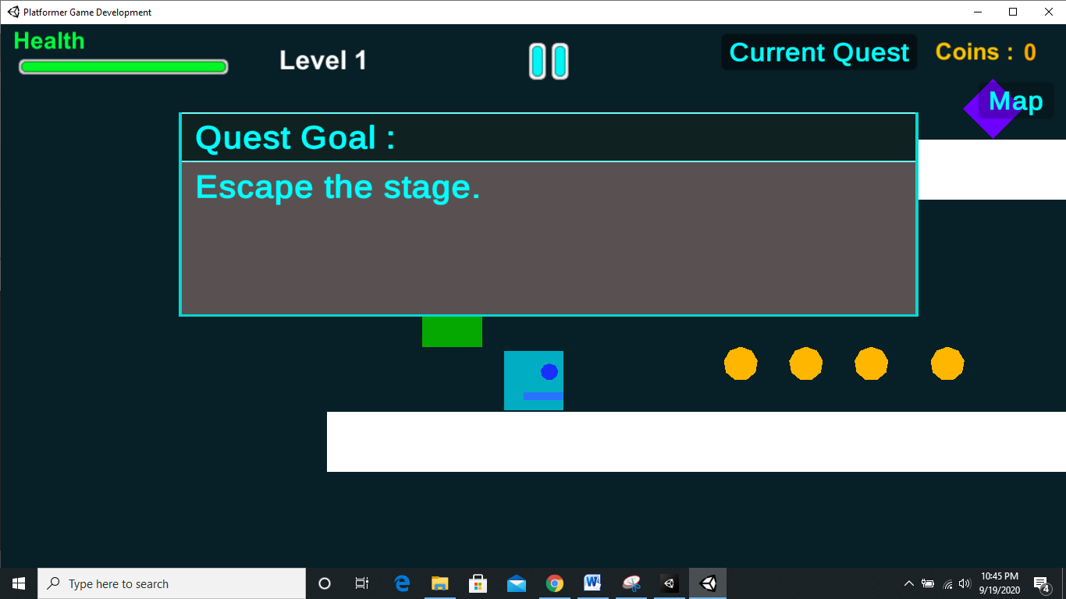
Level 1 Scene
Level 1 Quest

Slide 17
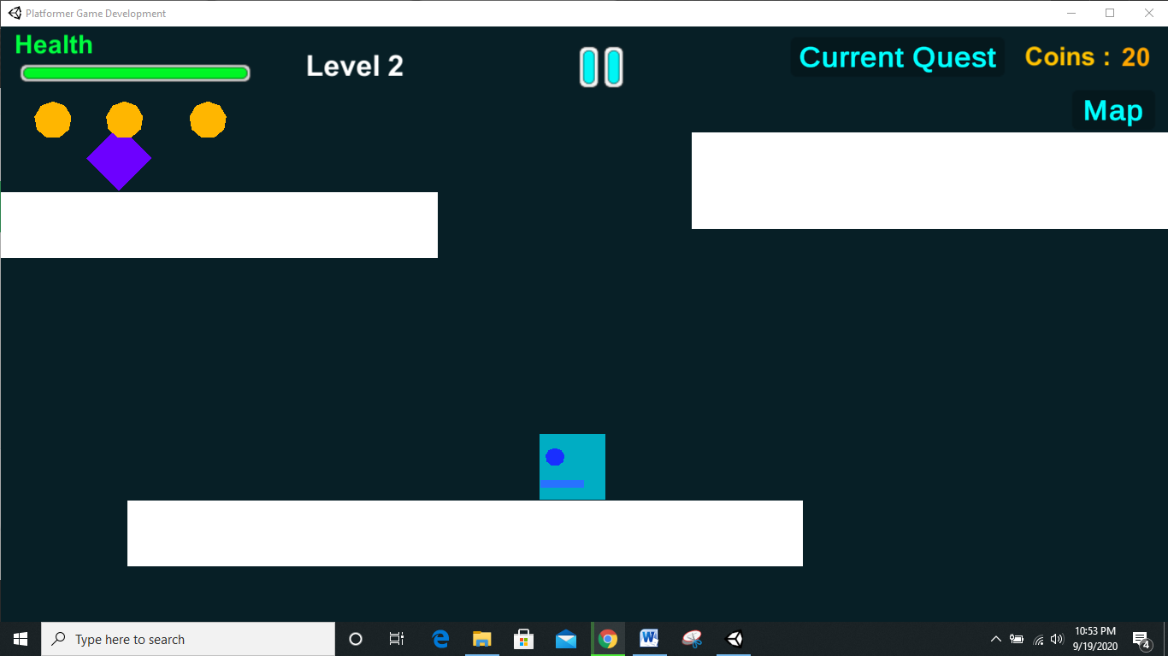
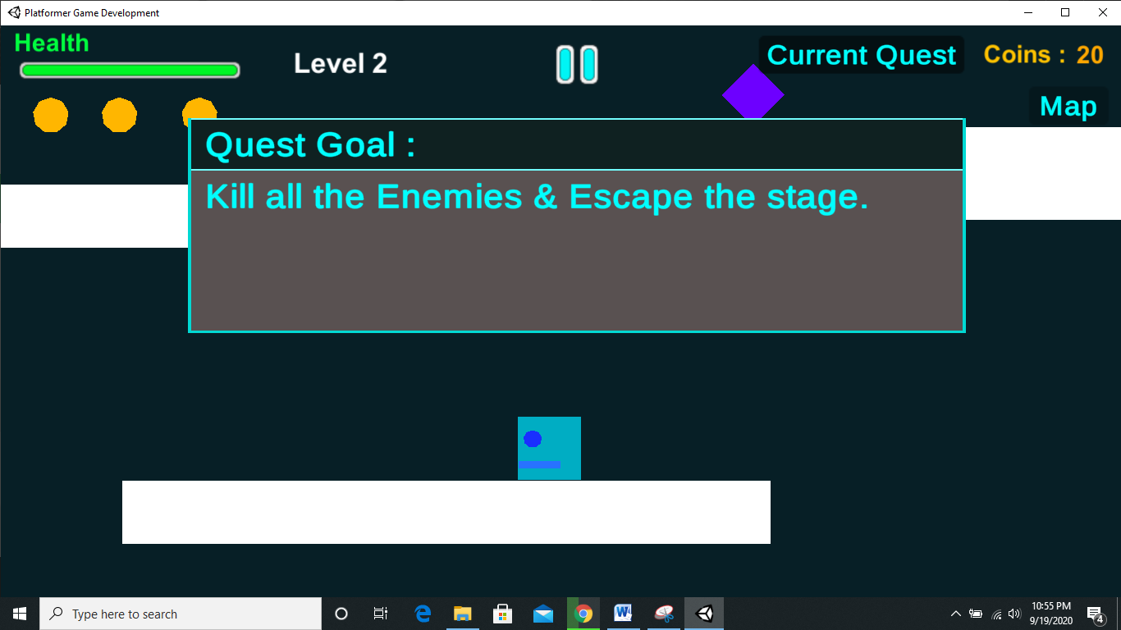
Level 2 Scene
Level 2 Quest

Slide 18
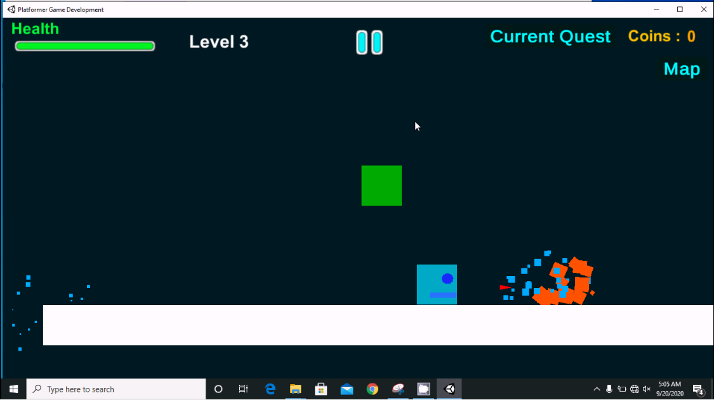
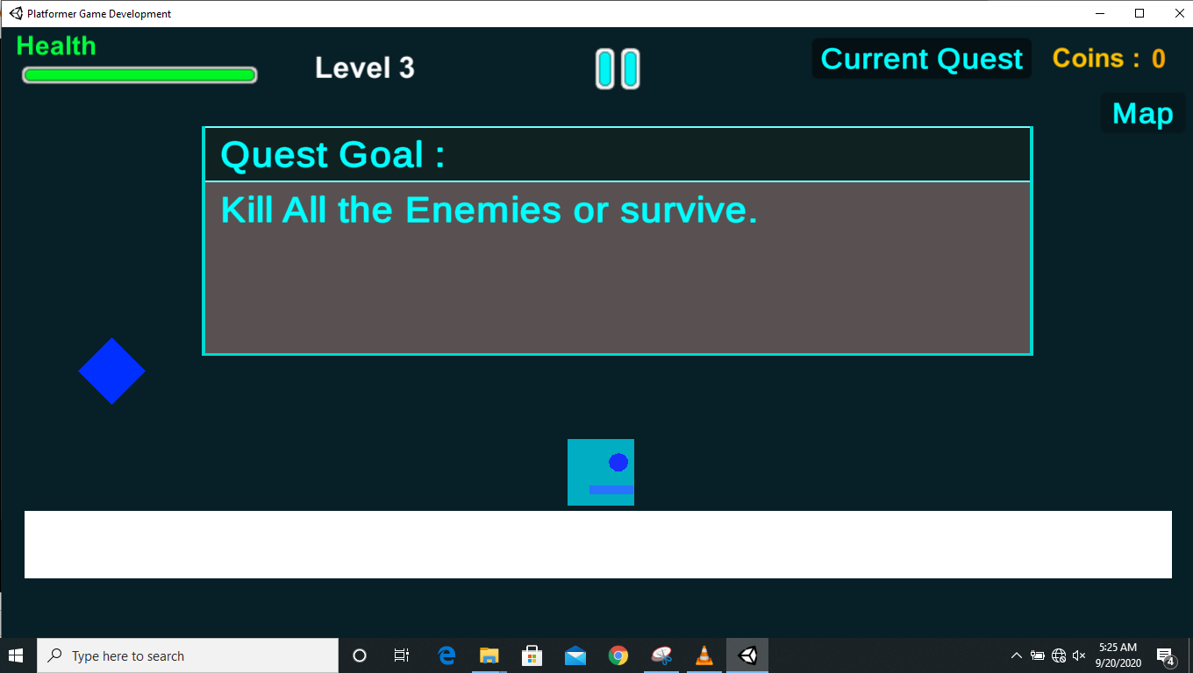
Level 3 Scene
Level 3 Quest

Slide 19
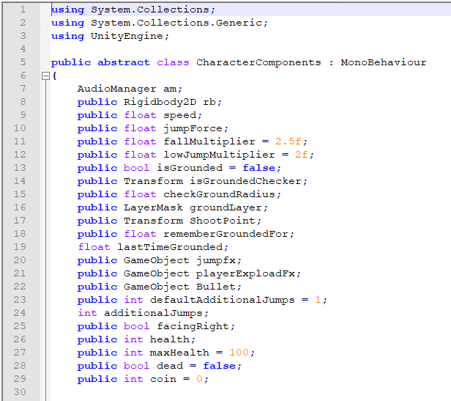
CharacterController.cs
CharacterController.cs

Slide 20
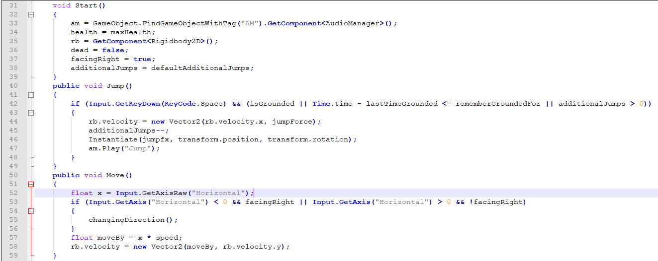
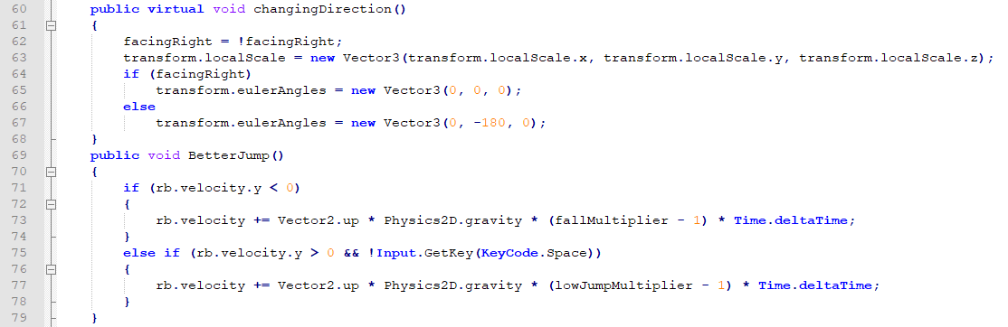
CharacterController.cs

Slide 21
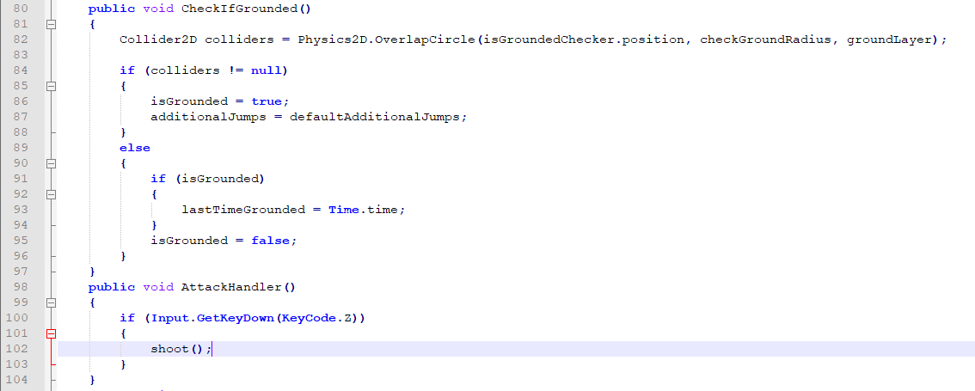
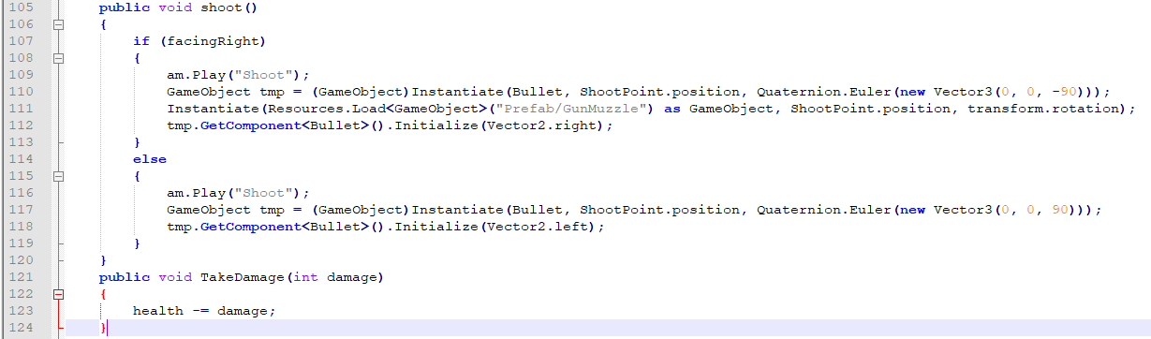
CharacterController.cs

Slide 22
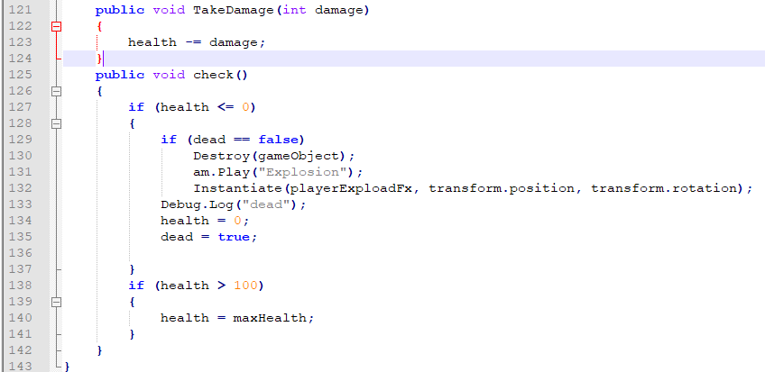
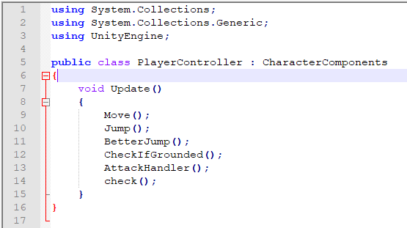
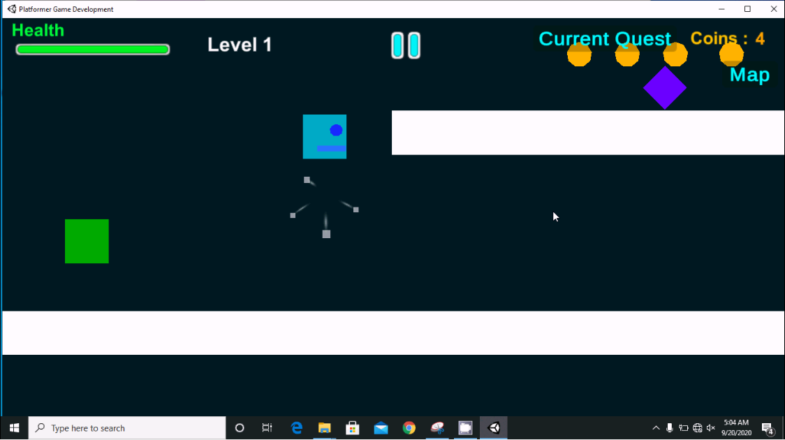
CharacterController.cs
PlayerController.cs
Player

Slide 23
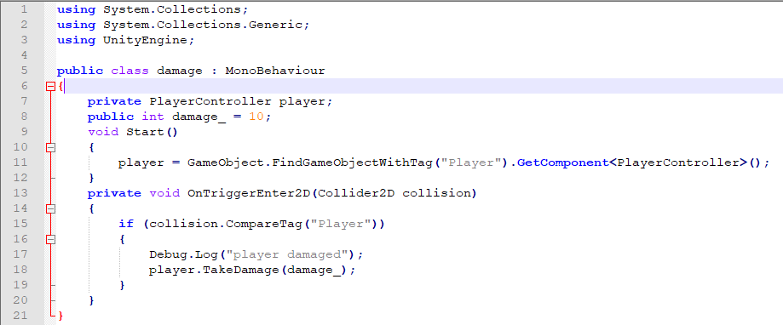
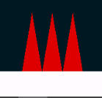
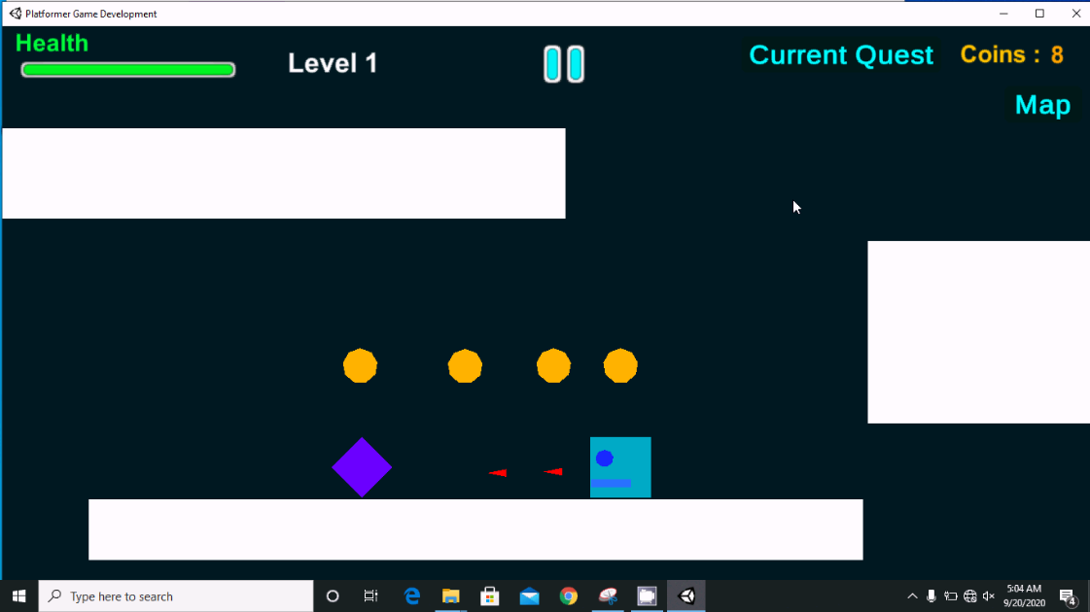
Damage.cs
Damage.cs
Damager :
Spikes
Enemy

Slide 24
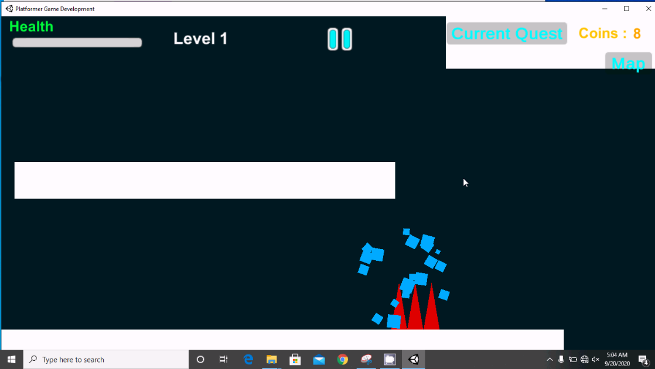
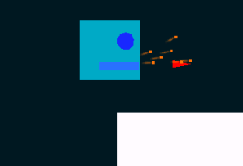
VerticalVelocity
Jumping
Damage, HealthBar Reduction
And Player Distruction VFX
Shooting
Shooting The Enemy

Slide 25
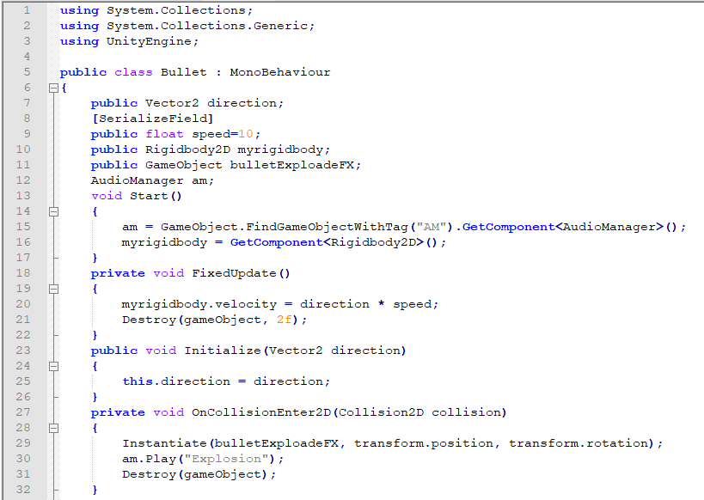
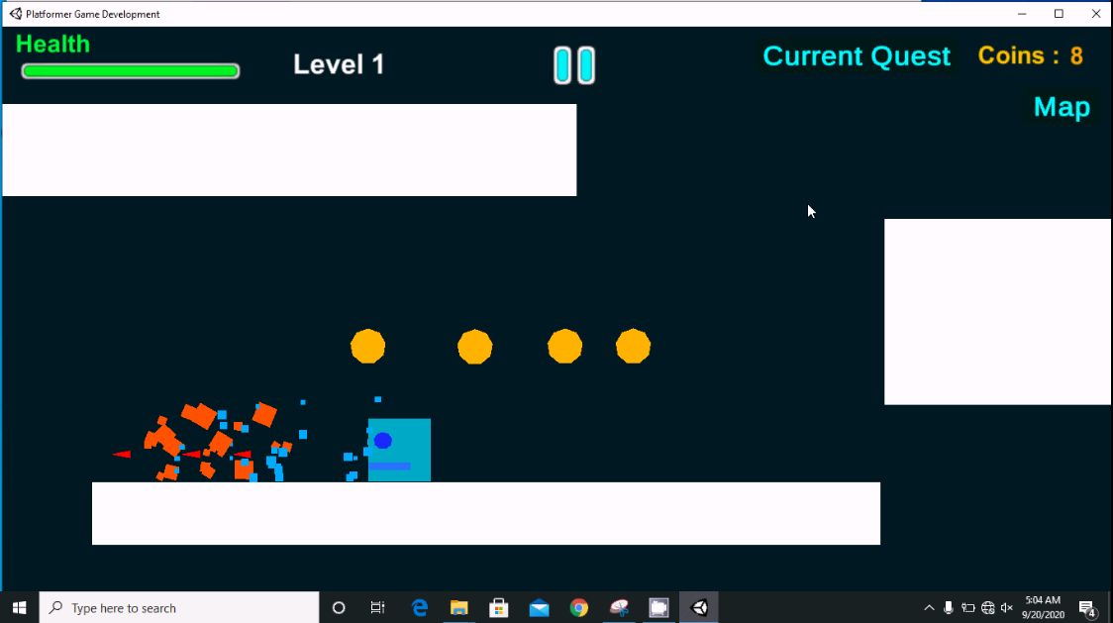
Bullet.cs
Bullet.cs
Bullet Explosion VFX
Bullet

Slide 26
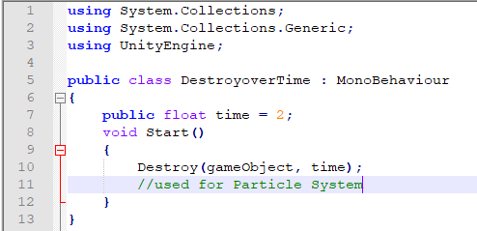
DestroyoverTime.cs
DestroyoverTime.cs
This Script is attached to BulletGameObject So that it will be Destroyed after 2 seconds from the time of Instantiated if it doesn,t hit anything.

Slide 27
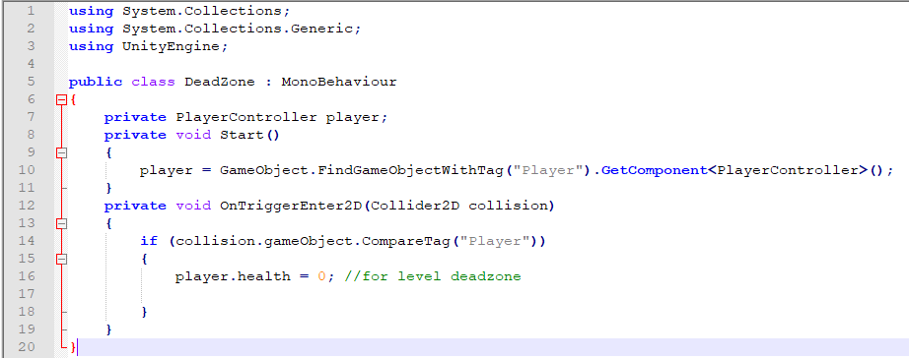
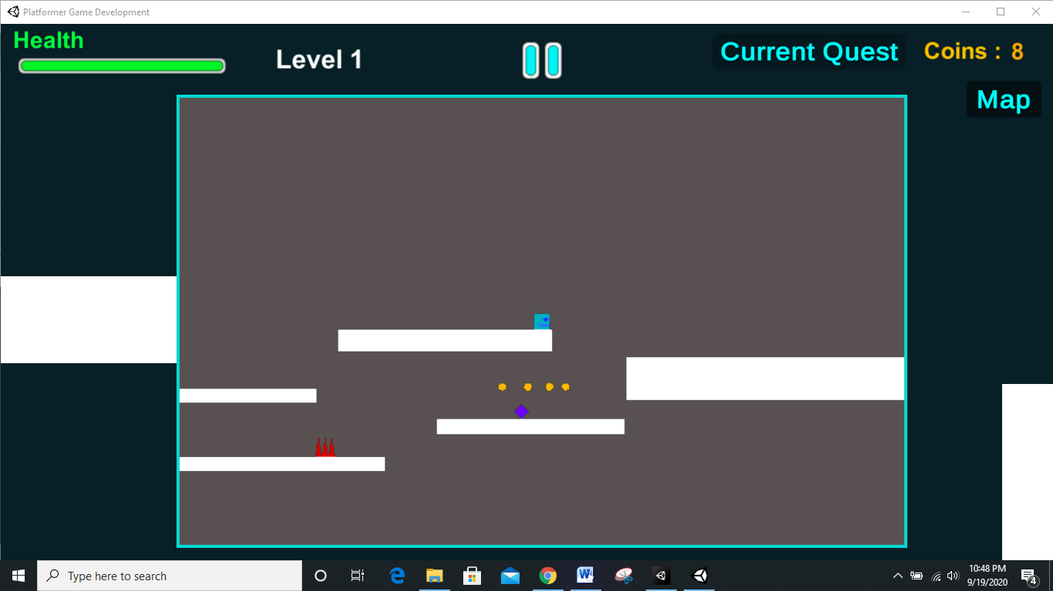
DeadZone.cs
DeadZone.cs
DeadZone

Slide 28
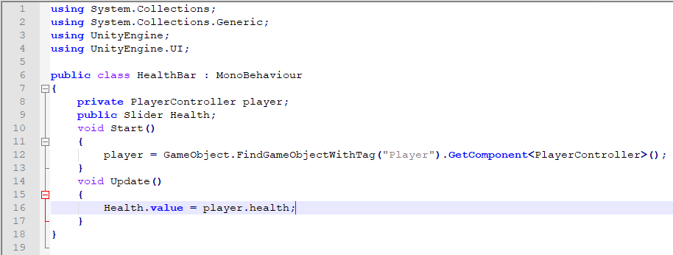
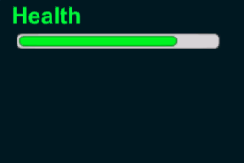
HealthBar.cs
HealthBar.cs
HealthBar Slider and Health Text

Slide 29
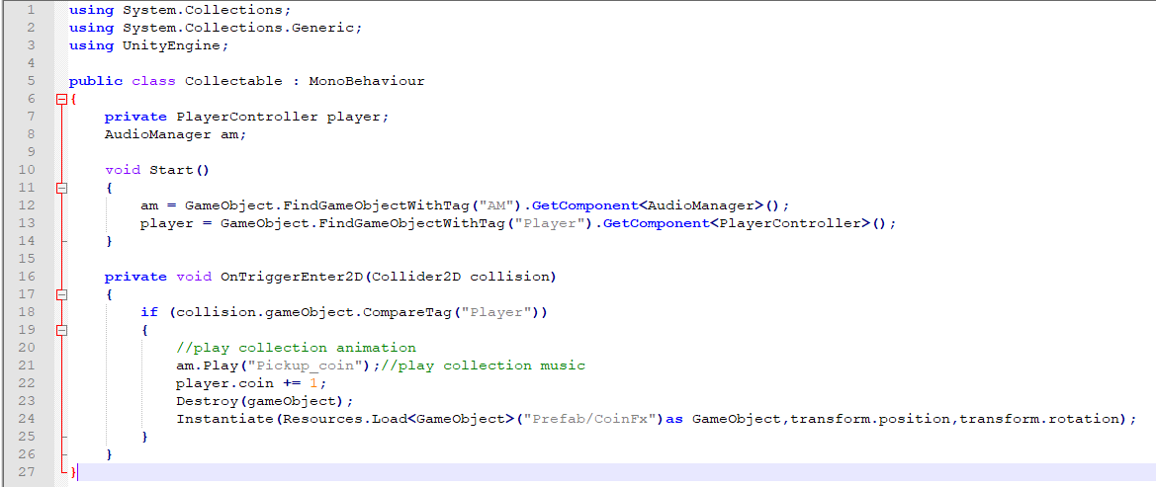
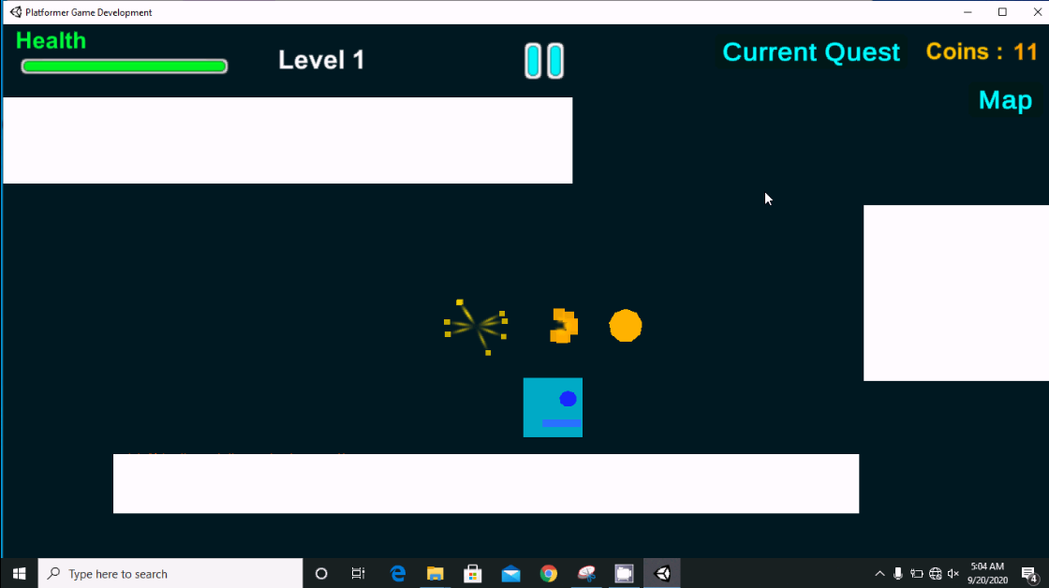
Collectable.cs
Collectable.cs
Script Attached to coin Object for collision detection and CoinCollectionVFX.
Coin VFX

Slide 30
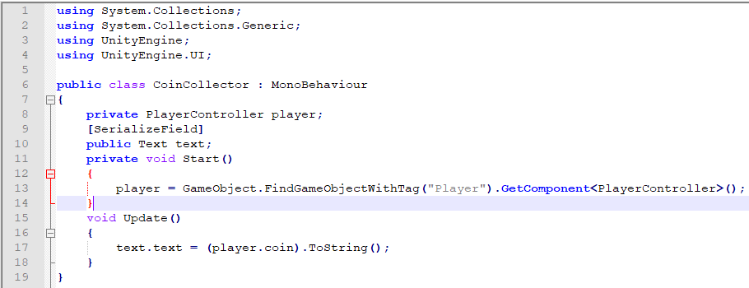
CoinCollector.cs
CoinCollector.cs
Coin
It just Shows the Collected Coins in UI as No Text.
Coins Text and CoinNo. Text

Slide 31
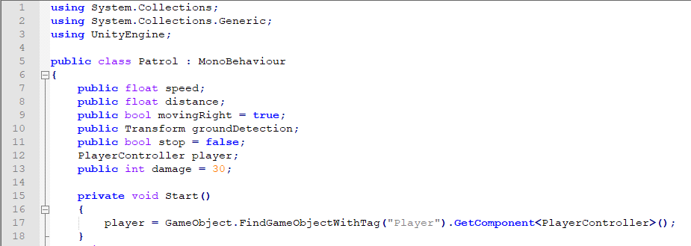
Patrol.cs
Enemy Patrol
Enemy
Velocity
Ground Check
Ground (Platform)
Patrol.cs

Slide 32
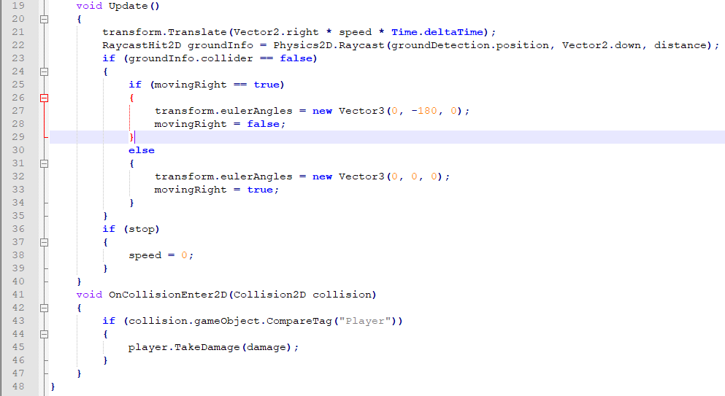
Patrol.cs

Slide 33
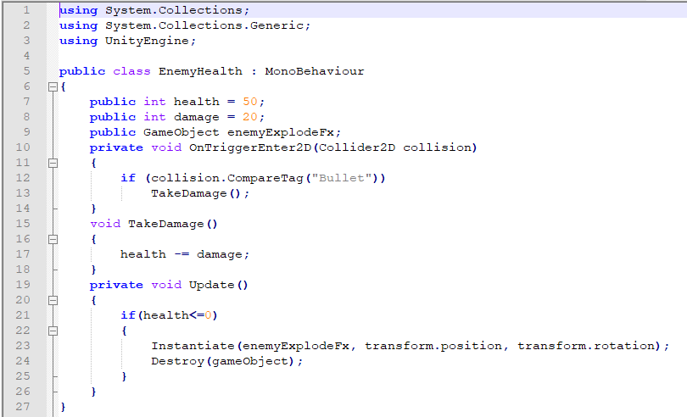
EnemyHealth.cs
EnemyHealth.cs
It is attached to the EnemyGameObject.

Slide 34

MinMapCameraFollow.cs
MinMapCameraFollow.cs
Camera follow script is Attached to Player GameObject and the Camera Input is Saved as texture and then That texture is Projected to the MiniMap Image UI in Game Screen.

Slide 35
MiniMap
Mini Map

Slide 36


Teleporter2.cs
Teleporter2.cs
Teleporter
It Loads the Next Level when Player Triggers it by Collision.

Slide 37


Spawn.cs
Spawn.cs
Level 3 Level Design
Enemy Spawn Point

Slide 38

Spawn.cs

Slide 39


CompleteGame.cs
CompleteGame.cs
Game Completion Scene

Slide 40

GameManager.cs
GameManager.cs

Slide 41

GameManager.cs

Slide 42

SceneManager.cs
SceneManager.cs

Slide 43


SceneManager.cs

Slide 44

Sound.cs
Sound.cs

Slide 45

AudioManager.cs
AudioManager.cs

Slide 46

AudioManager.cs

Slide 47

AudioManager.cs

Slide 48

DB.cs
DB.cs

Slide 49


DB.cs

Slide 50


DB.cs
Save Table

Slide 51
Thank You
Made By Pawan P. Yadav

